Slide 1
Weekly Presentation
Jiayu Chen
2023.8.21
Notes:
Ok, I will begin my weekly Presentation

Slide 2
Work Description
Work_1: Attempting to predict S and D using signals with a noise level of 0.8 by decomposition. The achieved MAE for S is 3.9, and for D is 5.8, compared to last week's values of S=13 and D=9.
Work_2: Attempting to predict S and D using signals with a noise level of 0.1 by getting template. Some interesting observations were made.
Work_3:Tutorial Writing
Work_4:Theoretical knowledge Learning

Slide 3
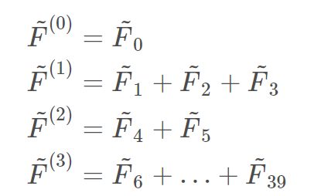
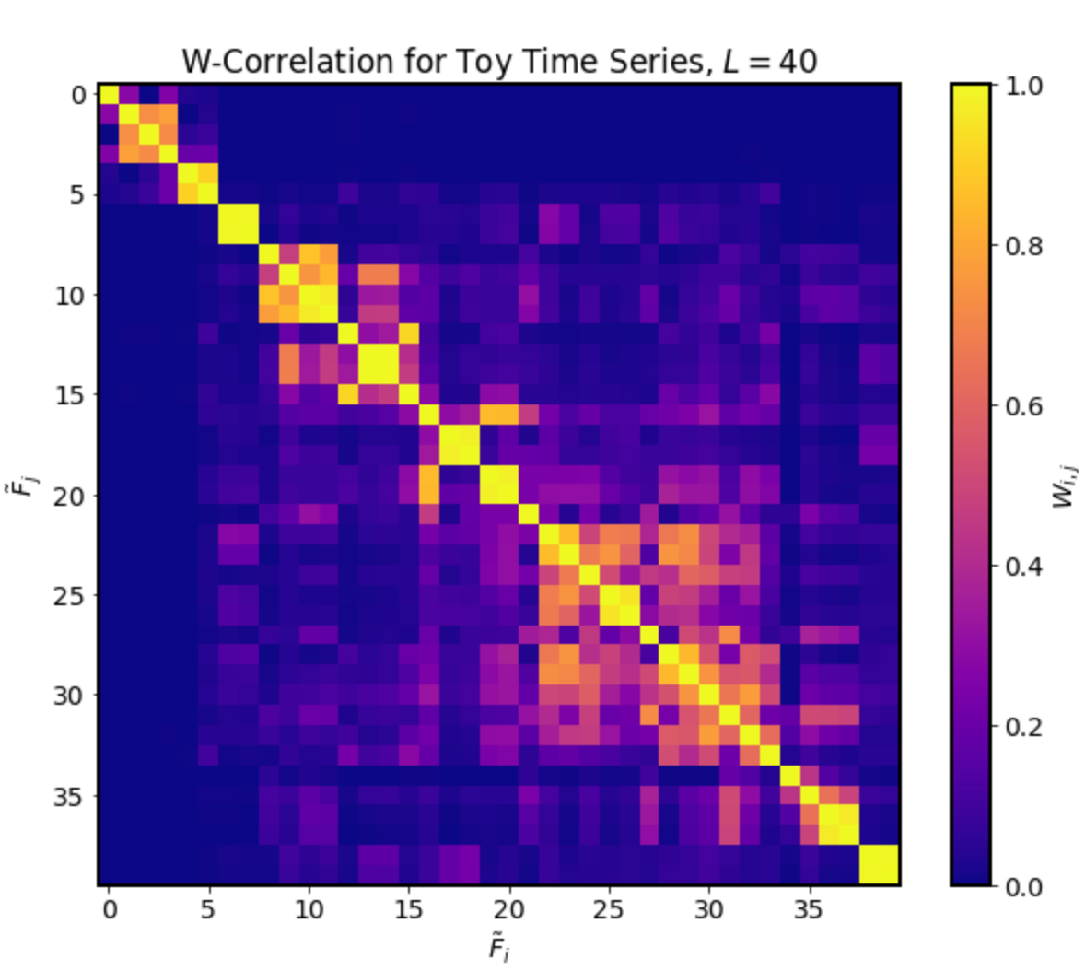
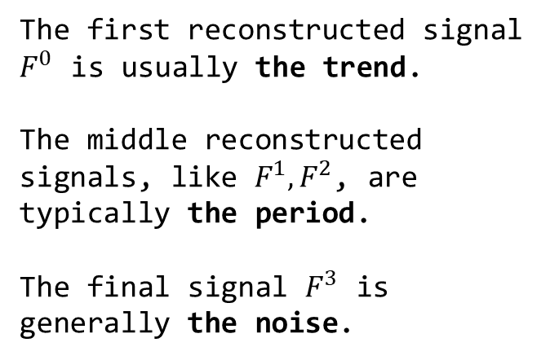
Work_1: S & D prediction in the noise level of 0.8
Process of Singular
Spectrum Analysis (SSA)
Step2.
Time Series Component Separation and Grouping
Components of time series are grouped together through visual inspection.
Step1.
perform SVD on the processed signal, and compute the W-correlation coefficients
Step3.
Reconstruct signals based on the groups
The first reconstructed signal $F^{0}$ is usually the trend.
The middle reconstructed signals, like $F^{1}, F^{2}$, are typically the period.
The final signal $F^{3}$ is generally the noise.
Notes:
In this week's tutorial writing, I found that Singular Spectrum Analysis (SSA) works well for denoising SCG signals in high-noise situations.
Let's take a look at Process of Singular Spectrum Analysis .
Step one is performing Singular Value Decomposition (SVD) on the processed signal, and computing the W-correlation coefficients.
In step two, Time Series Component Separation and Grouping, components of time series are grouped together through visual inspection. Which means，I just look at the picture of W-correlation and divide it into several groups together manually. In this matrix, I identified 4 such blocks, corresponding to the four green boxes in the picture.
Currently, it seems there isn't an automated method for the grouping.
Step three involves reconstructing signals based on these groups.
signal components within the four green boxes are reconstructed into four signals.
The first reconstructed signal, 𝐹^0, usually represents the trend.
The middle reconstructed signals, like 𝐹^1, 𝐹^2, typically represent periodic components.
The final signal, 𝐹^3, usually represents noise.

Slide 4
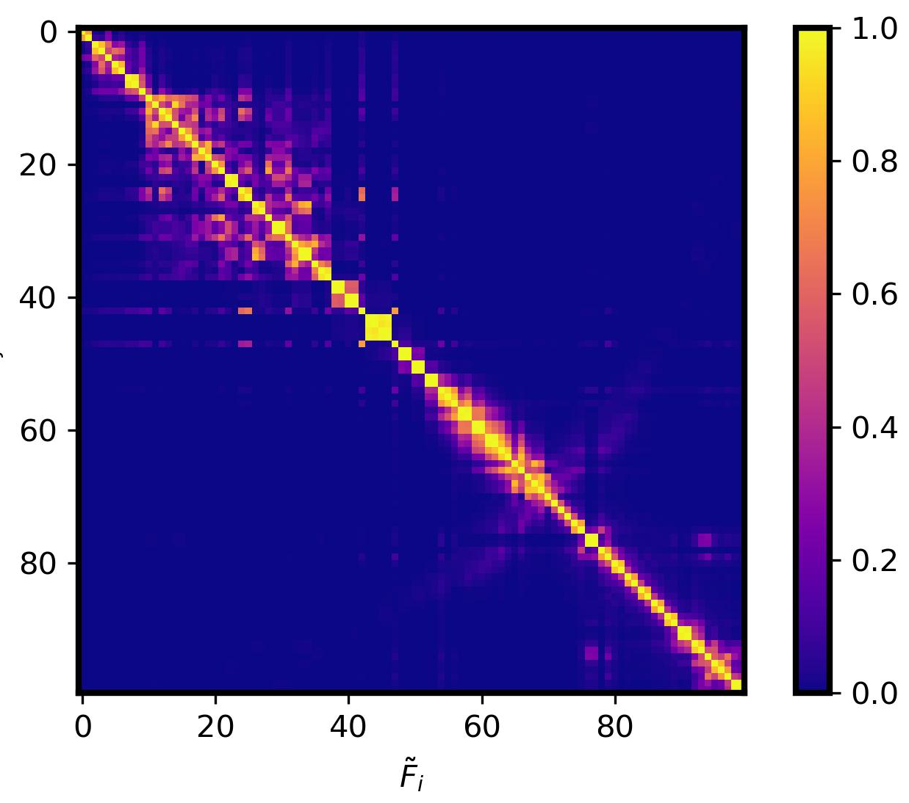
Work_1: S & D prediction in the noise level of 0.8
The process of simplified SSA I used
Step2.
Based on empirical values, components of time series are divided in two groups: Trend + (Period + Noise).
Step3.
Reconstruct signals based on the groups
Step1.
perform SVD on the processed signal, and compute the W-correlation coefficients
The first reconstructed signal is generally the trend.
The second reconstructed signal is a combination of the period and the noise.
W-correlation for SCG signal, L=100
W-correlation for SCG signal, L=100
Notes:
In practical situations, dealing with thousands of SCG signals makes it impossible to apply Step 2 of SSA, which involves visual inspection and subjective grouping. Thus, practical application becomes challenging.
Here is The process of simplified SSA I used
I've made a change in Step 2. Instead of dividing it into 3 groups, I divide it into two main groups: Trend + (Period + Noise). The point of division between these two components are determined based on empirical values.

Slide 5
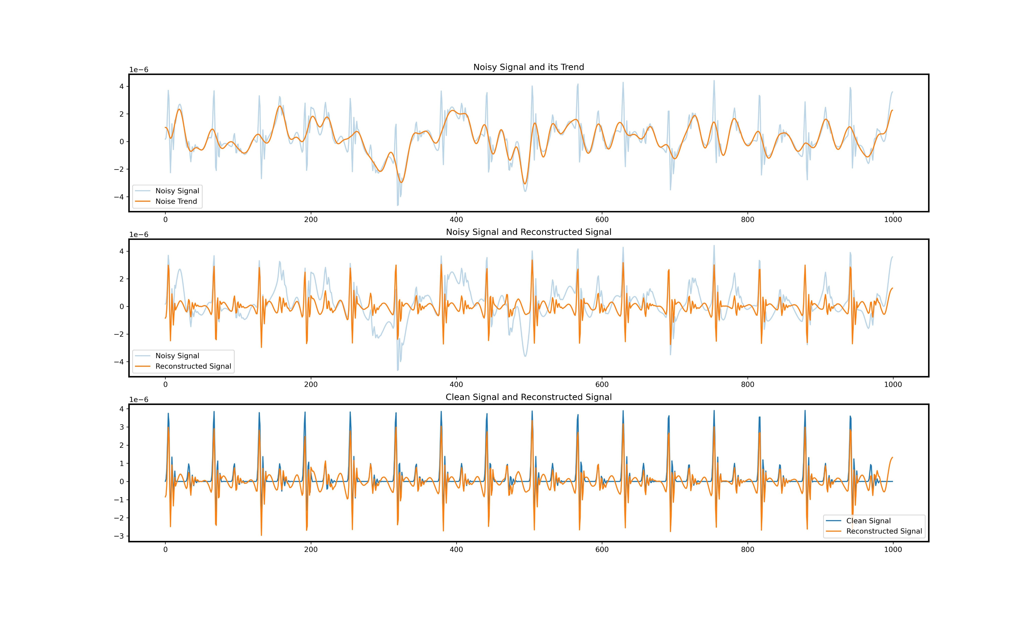
Work_1: S & D prediction in the noise level of 0.8
The effectiveness of denoising using SSA
Original SCG signal with a noise level of 0.8
Trend extracted using SSA
Original SCG signal with a noise level of 0.8
(Period + Noise) extracted using SSA
SCG signal with no noise
(Period + Noise) extracted using SSA
Notes:
This image is from my tutorial. In this image, the noise level of the SCG signal is 0.8.
In the first image, the blue line represents the original SCG signal with a noise level of 0.8. The yellow line represents the Trend component extracted using SSA. We can perfectly obtain the trend of the noisy signal.
In the second image, the yellow line represents the Period+Noise component extracted using SSA.
In the third image, the blue line represents a signal with no noise, while the yellow line means the Period+Noise component extracted using SSA.
We can clearly see from picture 3.
Peak features are very difficult to discern in the original signal with a noise level of 0.8
After applying SSA, Peaks can be accurately detected.

Slide 6
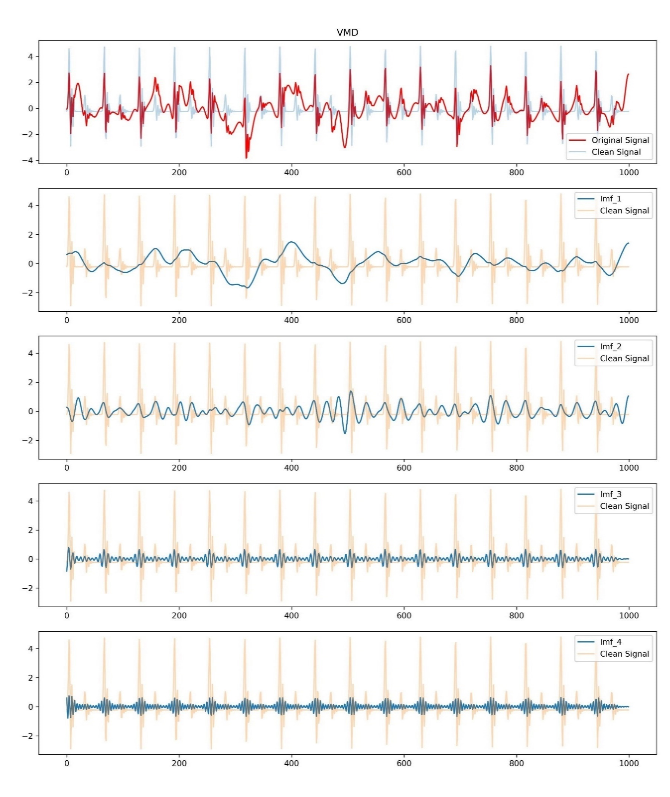
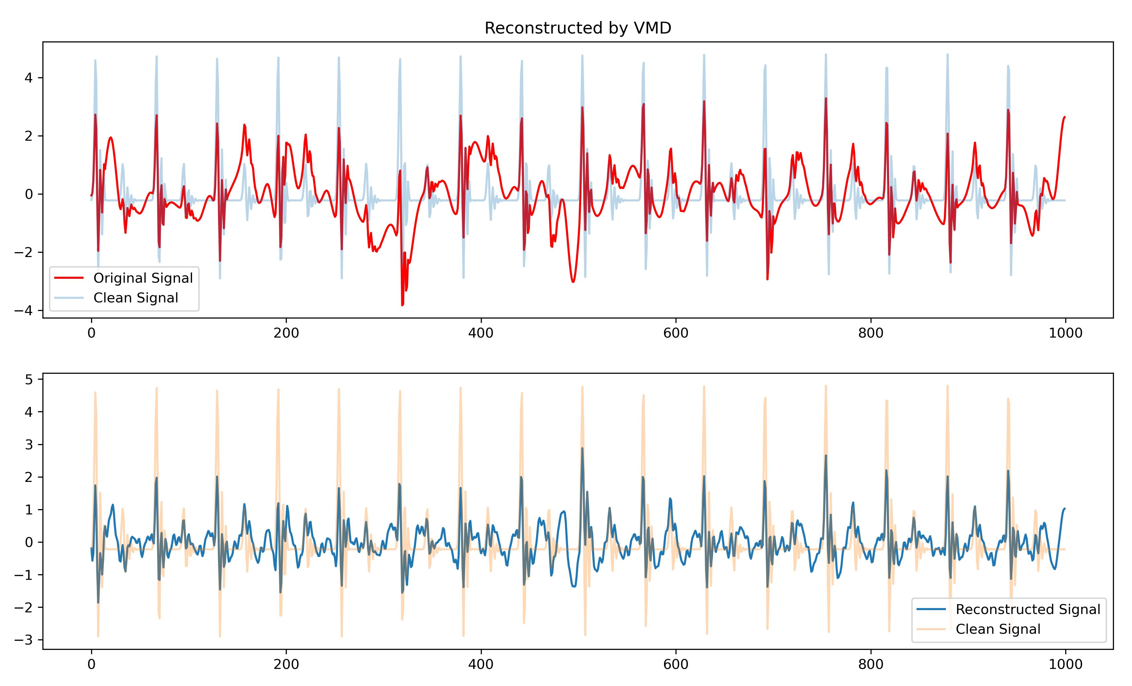
Work_1: S & D prediction in the noise level of 0.8
Effects of VMD
The decomposition of VMD
Reconstruction
The result isn’t very satisfactory.
Most peaks still couldn't be identified.
Notes:
Professor Song, I've individually tried out the four decomposition algorithms you mentioned in the Tutorial Outline.
I've performed decomposition on each of them and then reconstructed the signals. The denoising effects are depicted in figures.
The left part is the decomposition of VMD, and the right part is the performance of reconstructed signals.

Slide 7
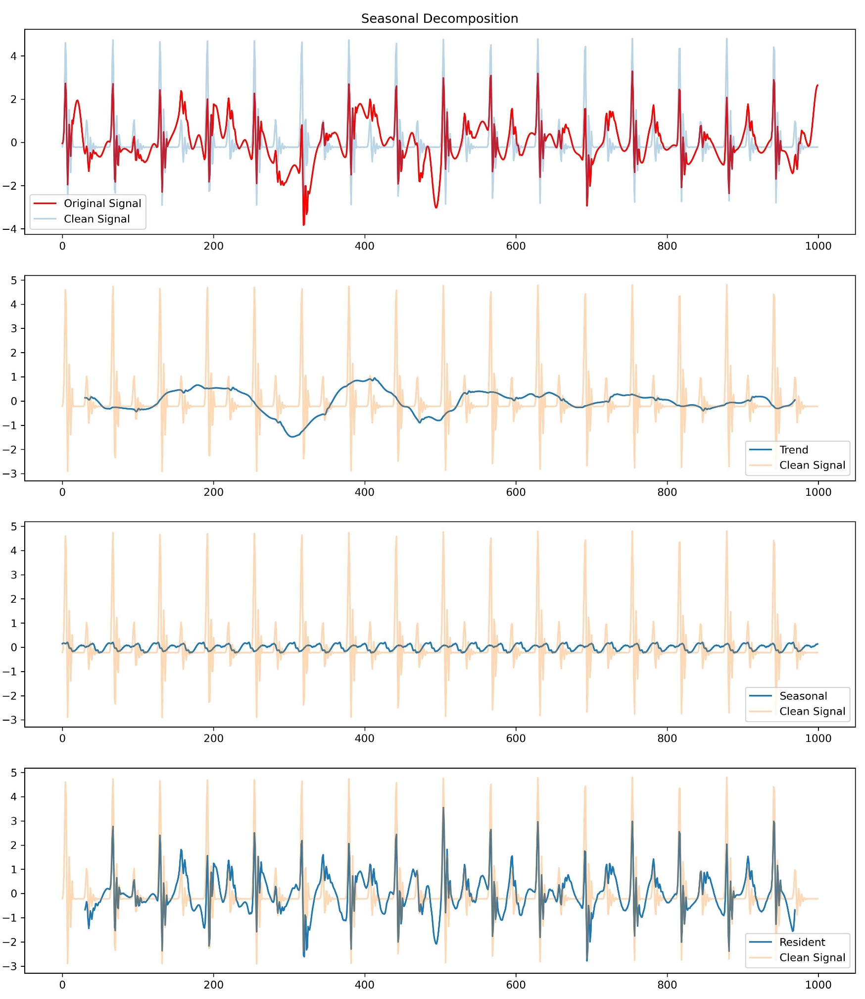
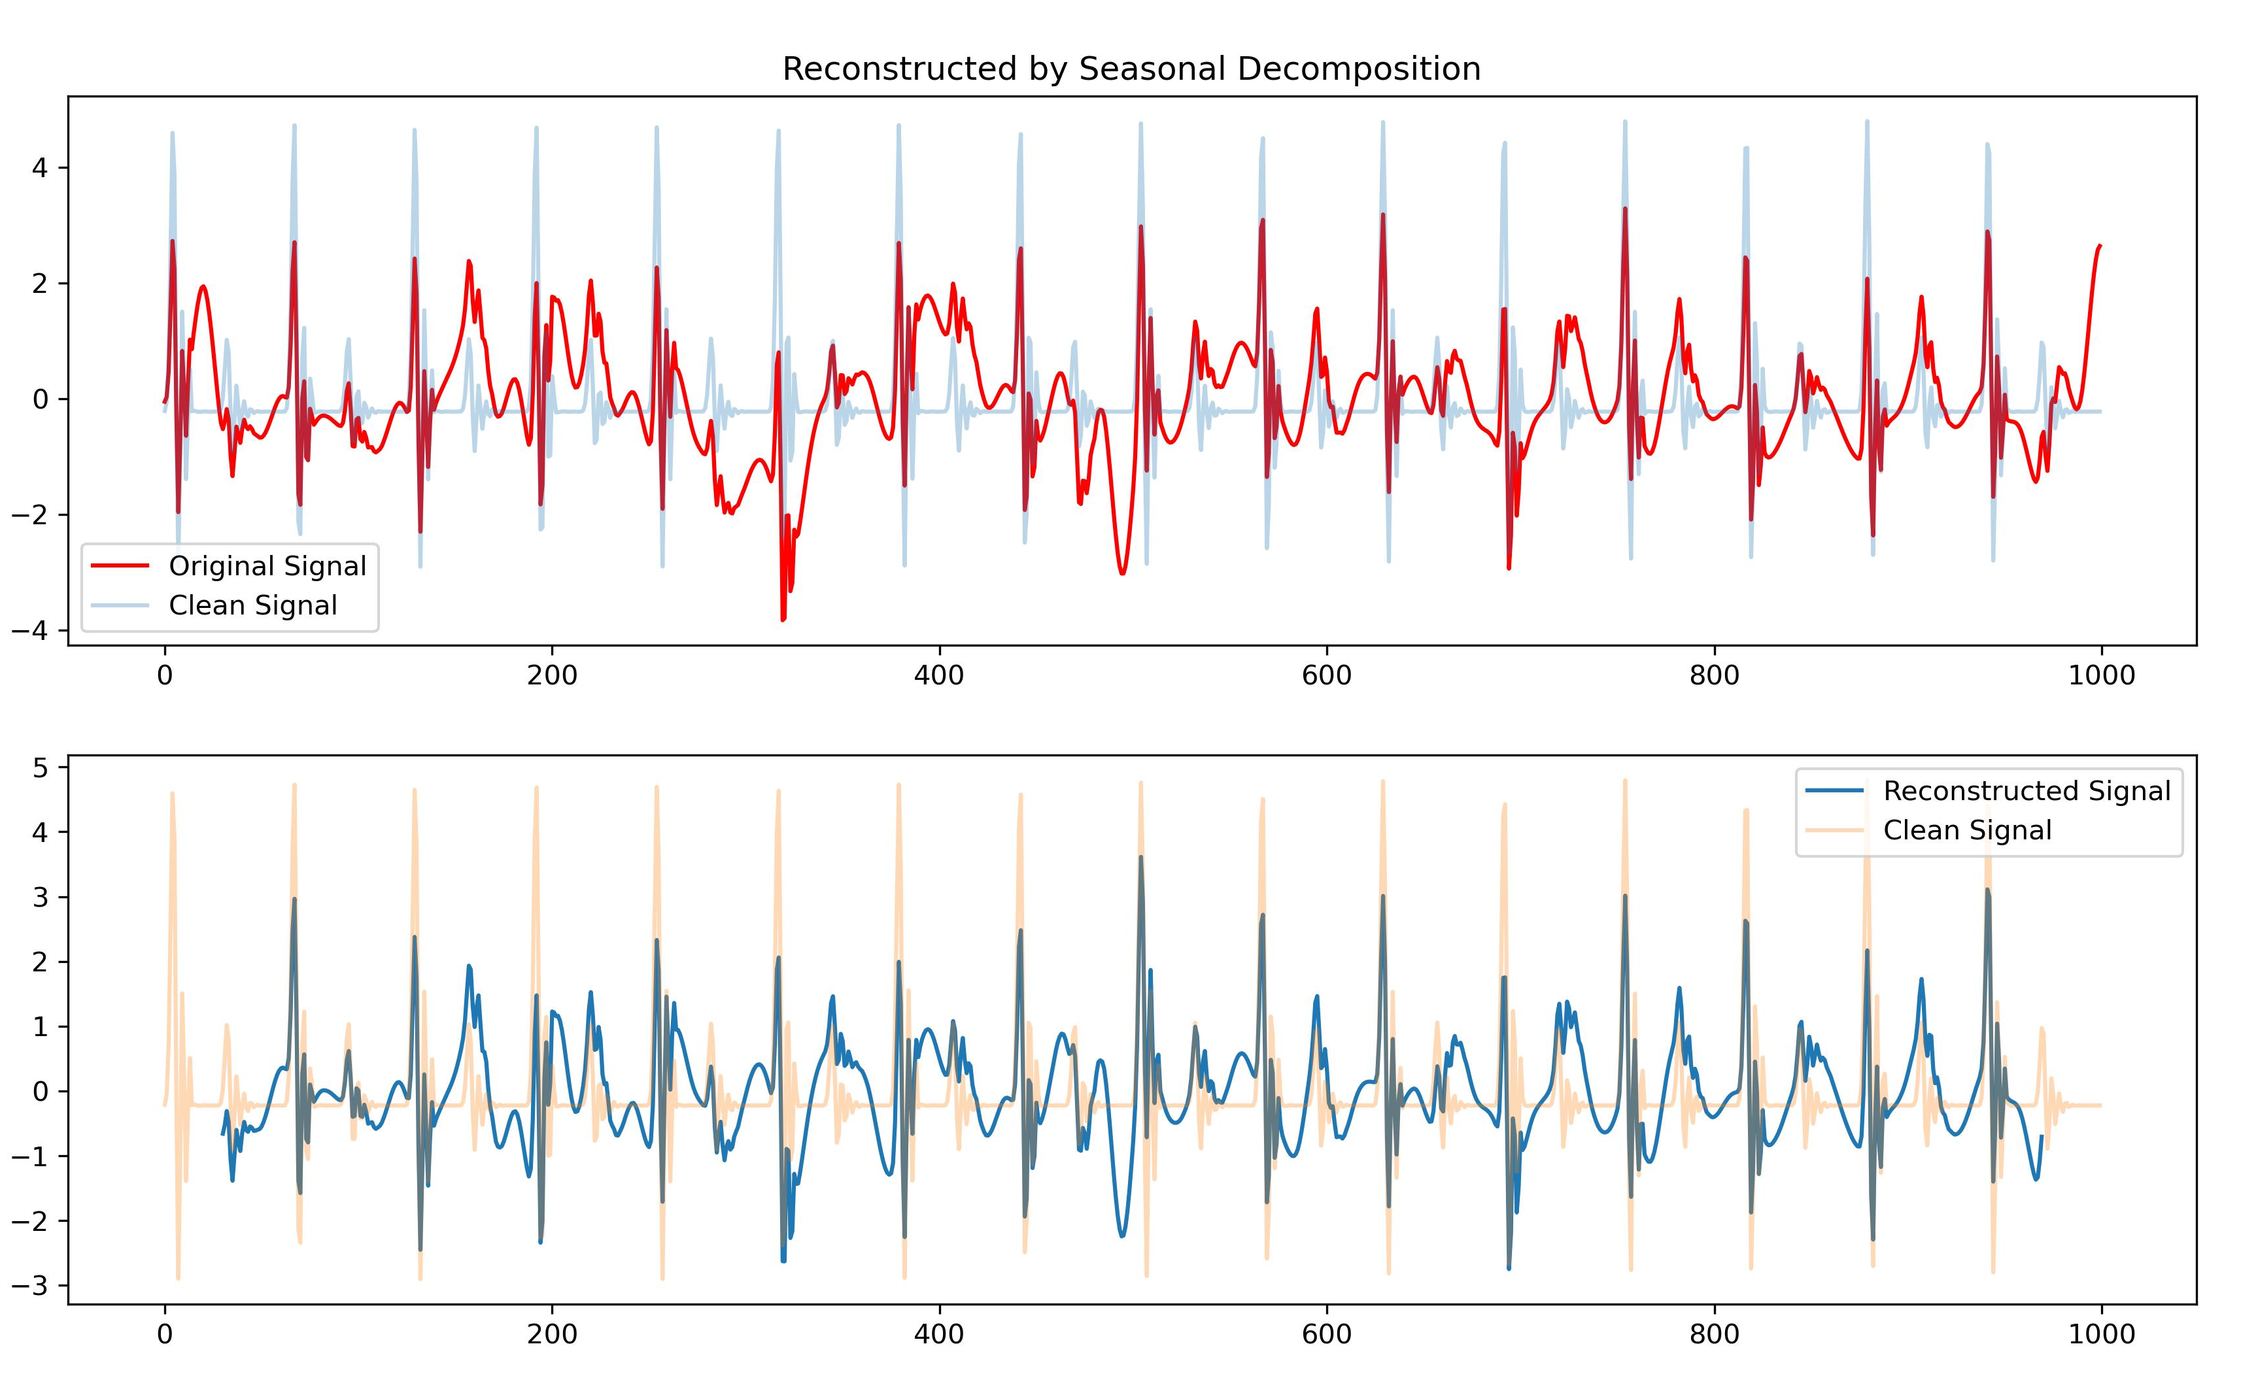
Work_1: S & D prediction in the noise level of 0.8
Effects of Seasonal Decomposition
The decomposition of STL
Reconstruction
The result isn’t very satisfactory.
Most peaks couldn't be identified too.

Slide 8
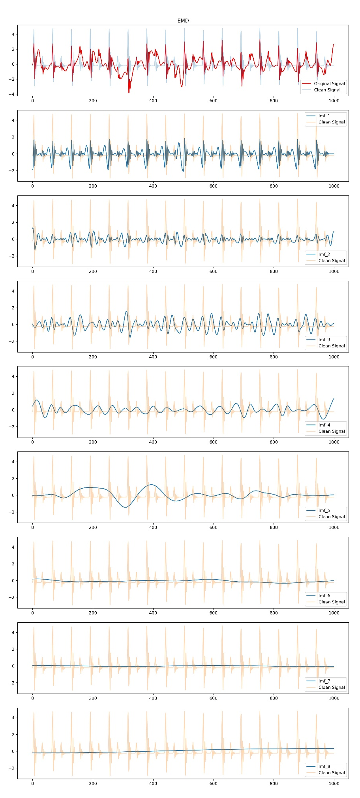
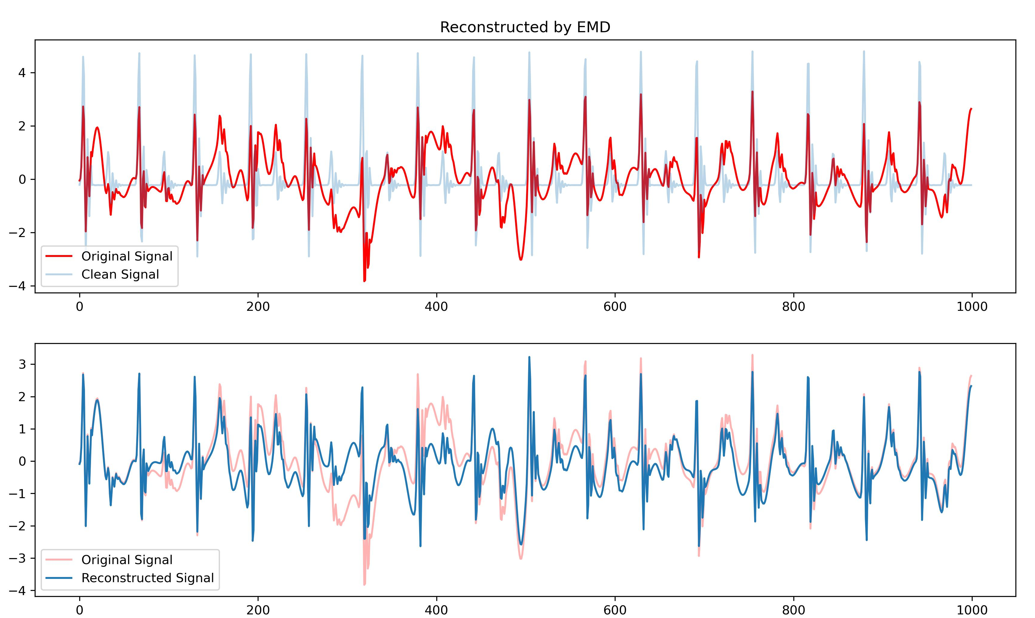
Work_1: S & D prediction in the noise level of 0.8
Effects of EMD
Reconstruction
Trend
The noise reduction effect is not ideal.
The reconstructed signal is still noisy.

Slide 9
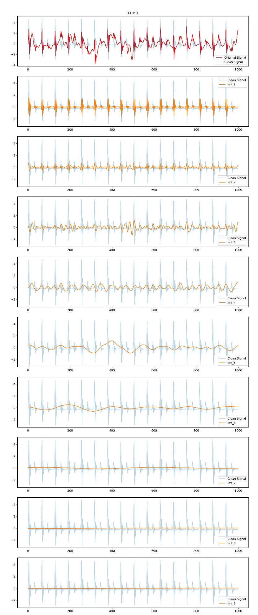
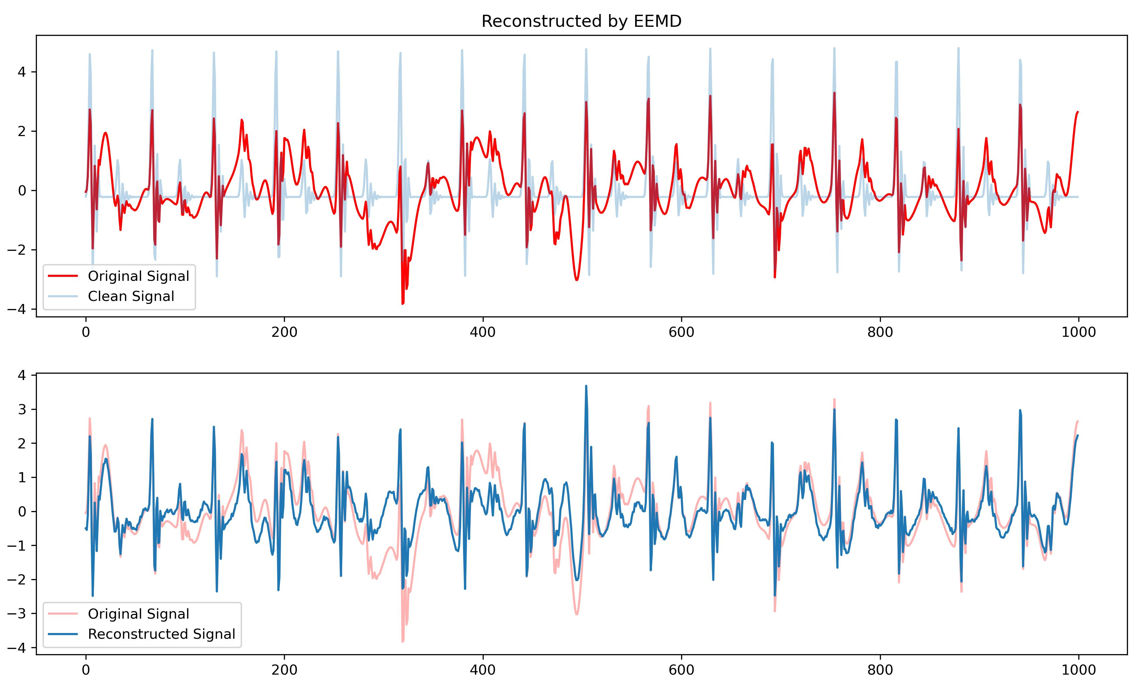
Work_1: S & D prediction in the noise level of 0.8
Effects of EEMD
Reconstruction
Trend
Noise reduction is better than EMD, but the effect is still poor.

Slide 10
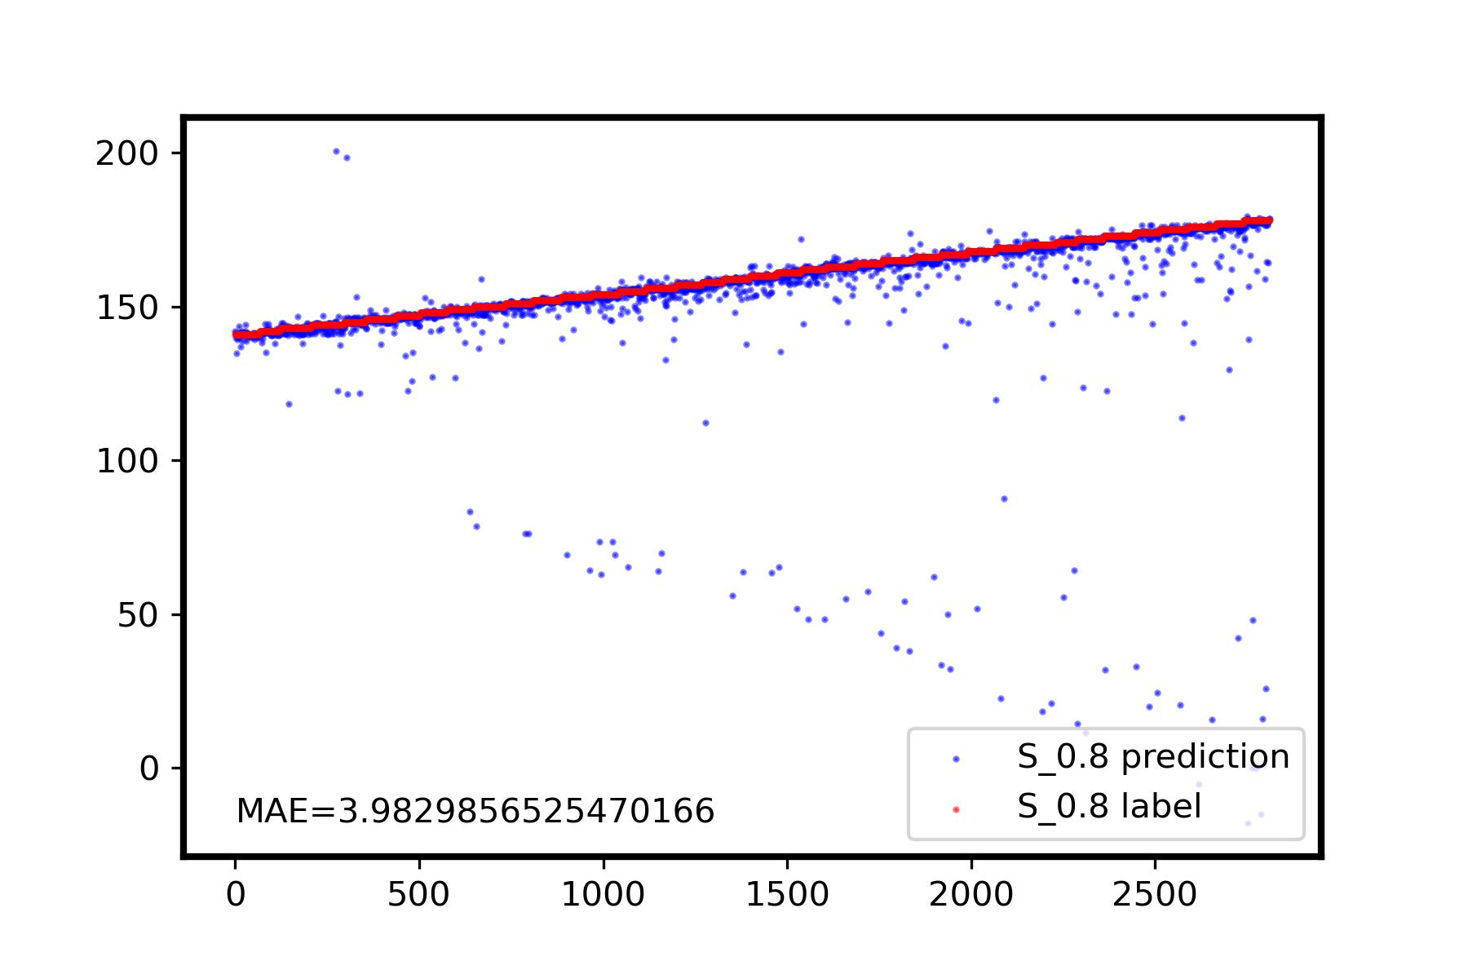
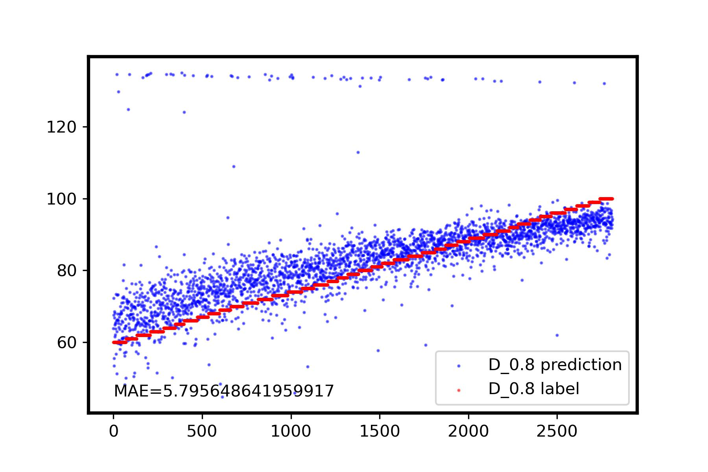
Work_1: S & D prediction in the noise level of 0.8
Prediction Results by using SSA
I believe this method has the potential to achieve MAE < 3 for the prediction of S and D, in the noise level of 0.8. Further optimization lies in achieving higher precision in grouping components of time series, rather than through visual inspection.
Surprisingly,
the high predictive accuracy for D using this method is amazing (last week I used IMF_1 of EEMD, it was completely unpredictable for D), as it suggests that the relative amplitude differences can be effectively restored.
I plan to delve into the mathematical principles to gain a clearer understanding next week.

Slide 11
Work_2: S & D prediction in the noise level of 0.1 by getting template
ideal
Data
(Noise: 0.1, No RR)
practical
Data
(Noise: 0.1, No RR)
Calculate period based on HR value
Calculate Period based on peaks detection
Period_distance =
(10s * sampling_rate) / (Peaks_num / 2)
Segmentation
Segmentation
One circle has a large peak and a small peak
K-shapes Clustering
K-shapes Clustering
Get Template
Get Template
…
…
Notes:
In the second work, I continued to experiment with using templates for prediction at a noise level of 0.1.
The left one is ideal, We can Calculate period based on HR value for cycle division directly. However, we found that employing this segmentation approach will cause some issues. In practice, I used a method that calculates Period based on peak detection. The calculation formula is shown on the right.

Slide 12
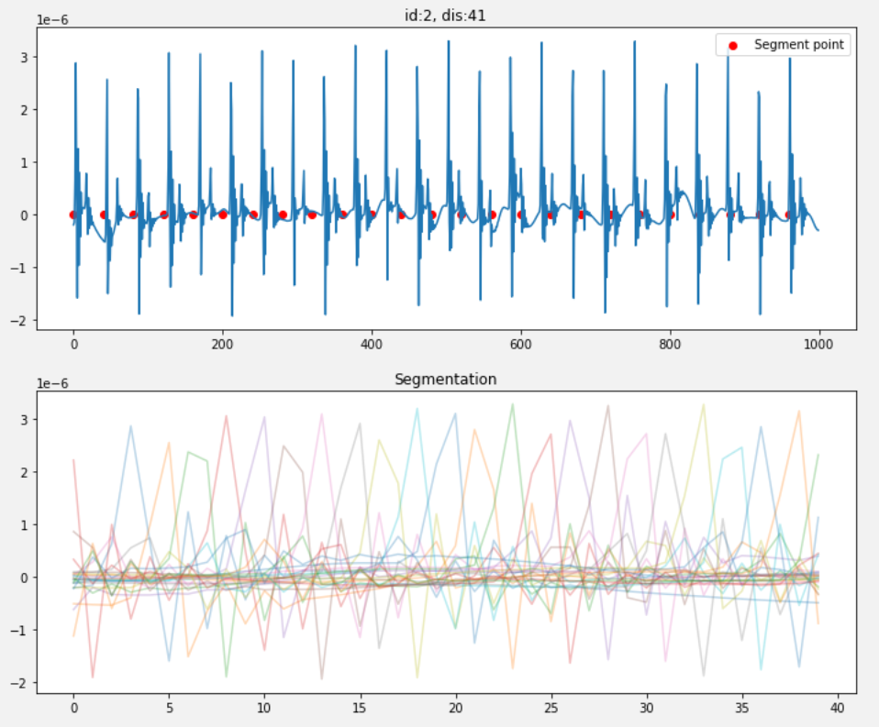
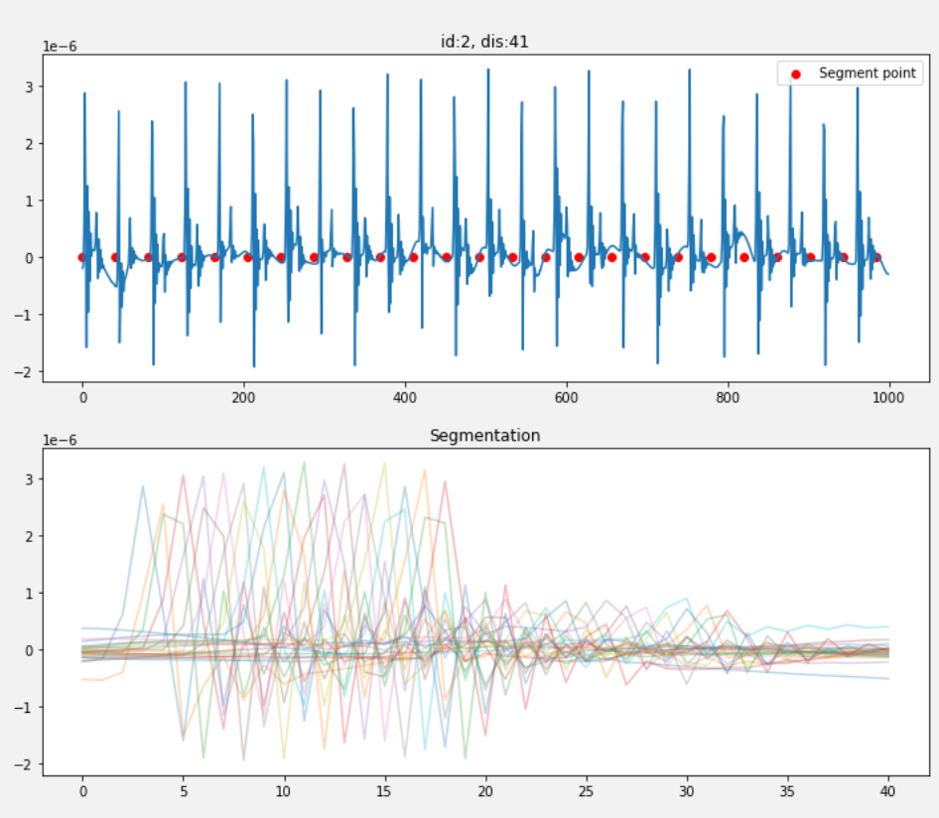
Work_2: S & D prediction in the noise level of 0.1 by getting template
Using HR-based segmentation, each segment has different shift phases.
The HR per minute is not equal to the HR for these ten seconds. Even a slight error can result in a poor performance.
Segmentation based on peak count yields much better results.
Notes:
Let’s look at the segmentation result

Slide 13
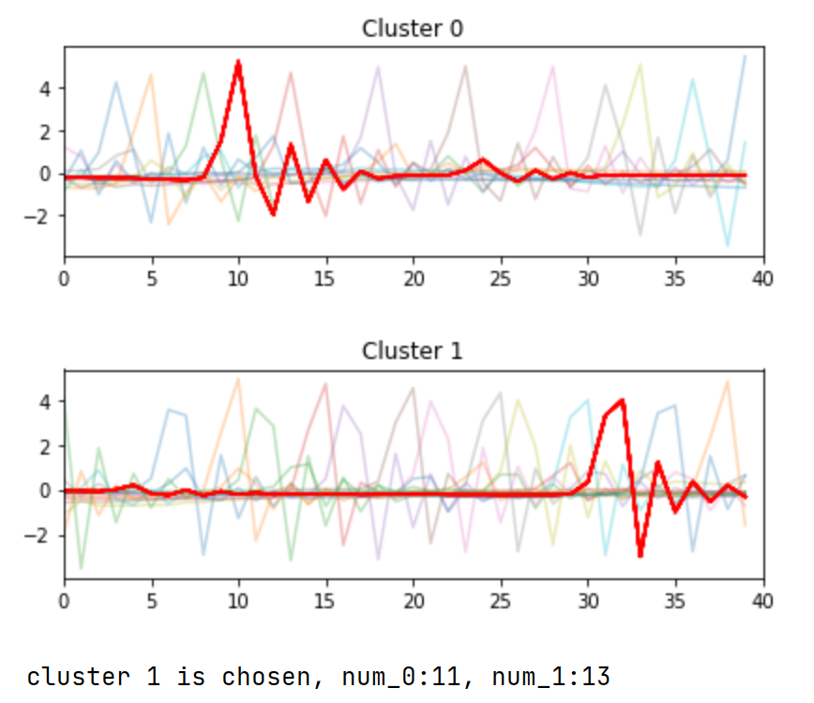
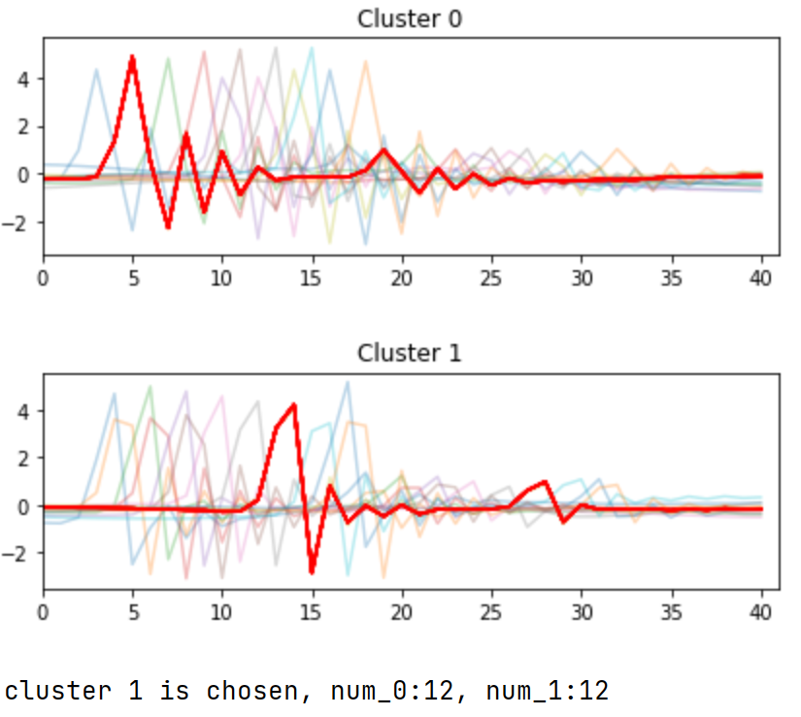
Work_2: S & D prediction in the noise level of 0.1 by getting template
Clustering results using HR-based segmentation
Left result is not satisfactory and worse than right one
Clustering results using segmentation based on peak count
Notes:
Let’s look at the clustering result

Slide 14
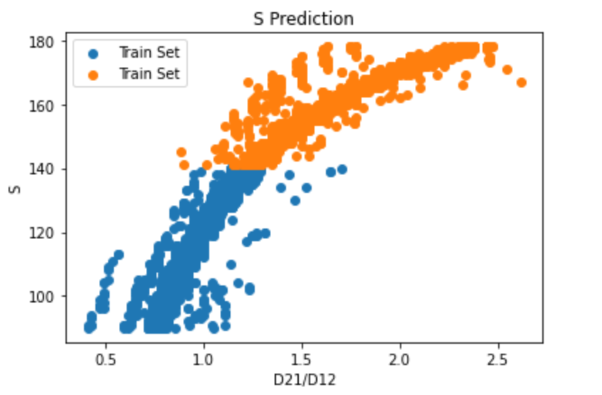
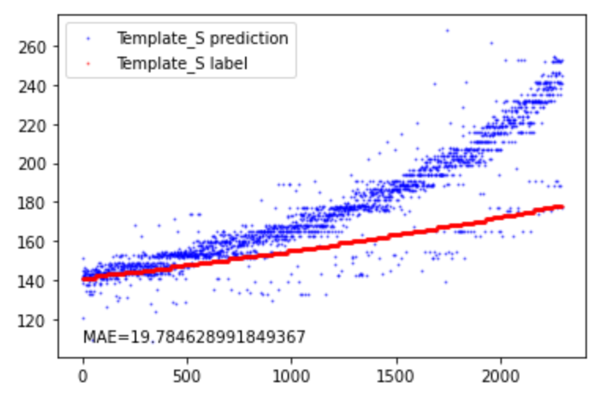
Work_2: S & D prediction in the noise level of 0.1 by getting template
Train Set
Test Set
Slope of Test Set
Slope of Train Set
A peculiar phenomenon observed in the S prediction
In the training set, correlation between D21/D12 and S reaches 0.95.
In the test set, correlation between D21/D12 and S also exceeds 0.9.
The feature extraction seems to be working perfectly.
However, their respective linear regression slopes differ significantly, leading to Template_S predictions often being higher than real values.
The exact cause of this peculiarity hasn't been determined yet.
Notes:
Here’s the results of using templates for S and D predictions.
There's a very peculiar phenomenon observed in the S prediction.
The peculiarity lies in the fact that:
In the training set, the correlation between D21/D12 and S reaches 0.95.
In the test set, the correlation between D21/D12 and S also exceeds 0.9.
The feature extraction seems to be working perfectly.
However, their respective linear regression slopes differ significantly, leading to Template_S predictions often being higher.
The exact cause of this peculiarity hasn't been determined yet.

Slide 15
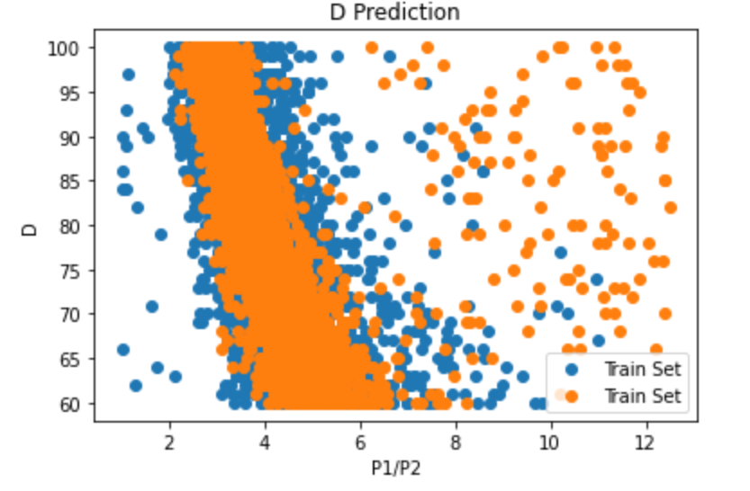
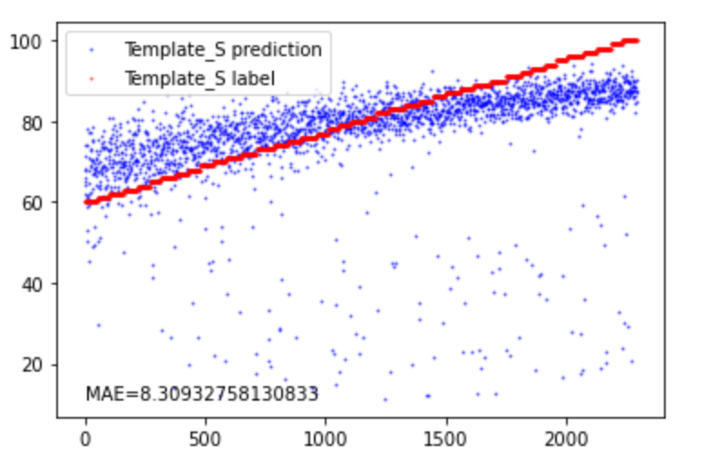
Work_2: S & D prediction in the noise level of 0.1 by getting template
Template_D prediction
Template_D label
Train Set
Test Set
outliers
Regarding D prediction, using templates for feature extraction seems to result in high number of outliers.
I suspect that this might be due to the influence of K-shapes on heights of small peaks.
I'm planning to work on eliminating this influence next week.

Slide 16
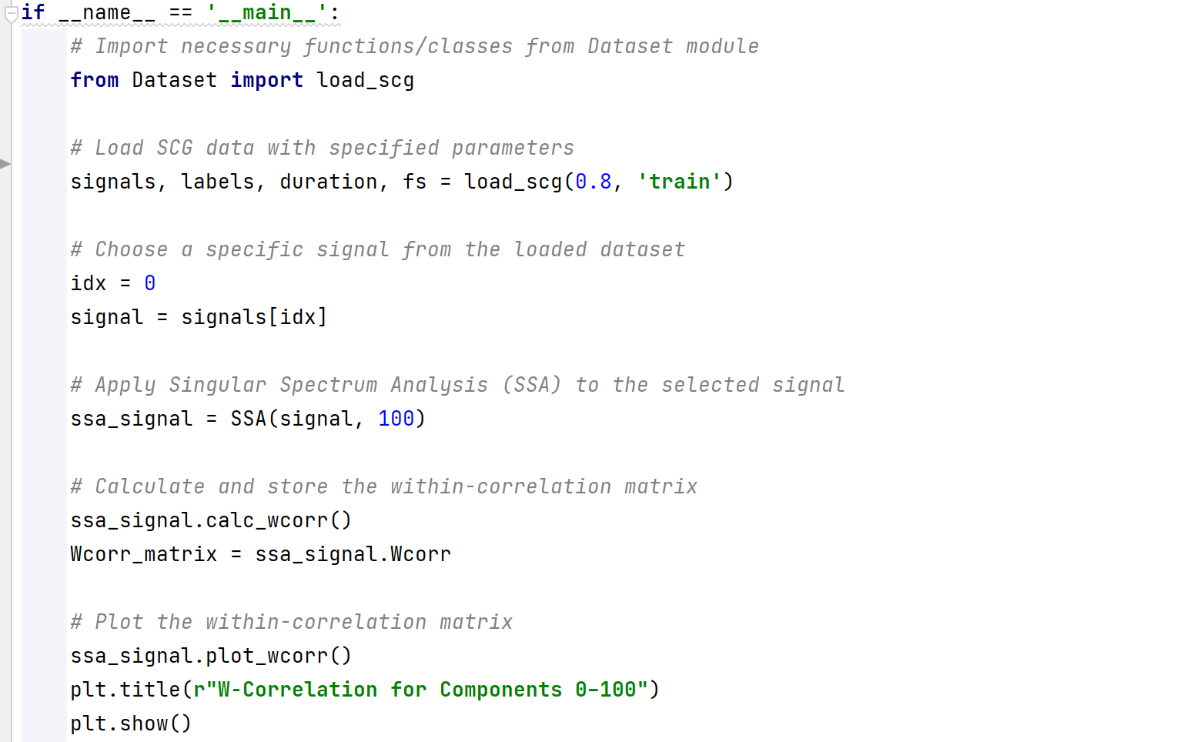
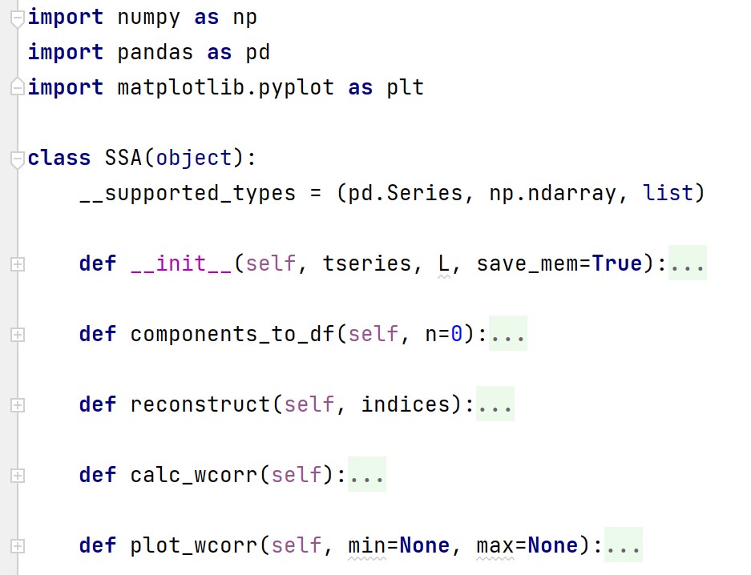
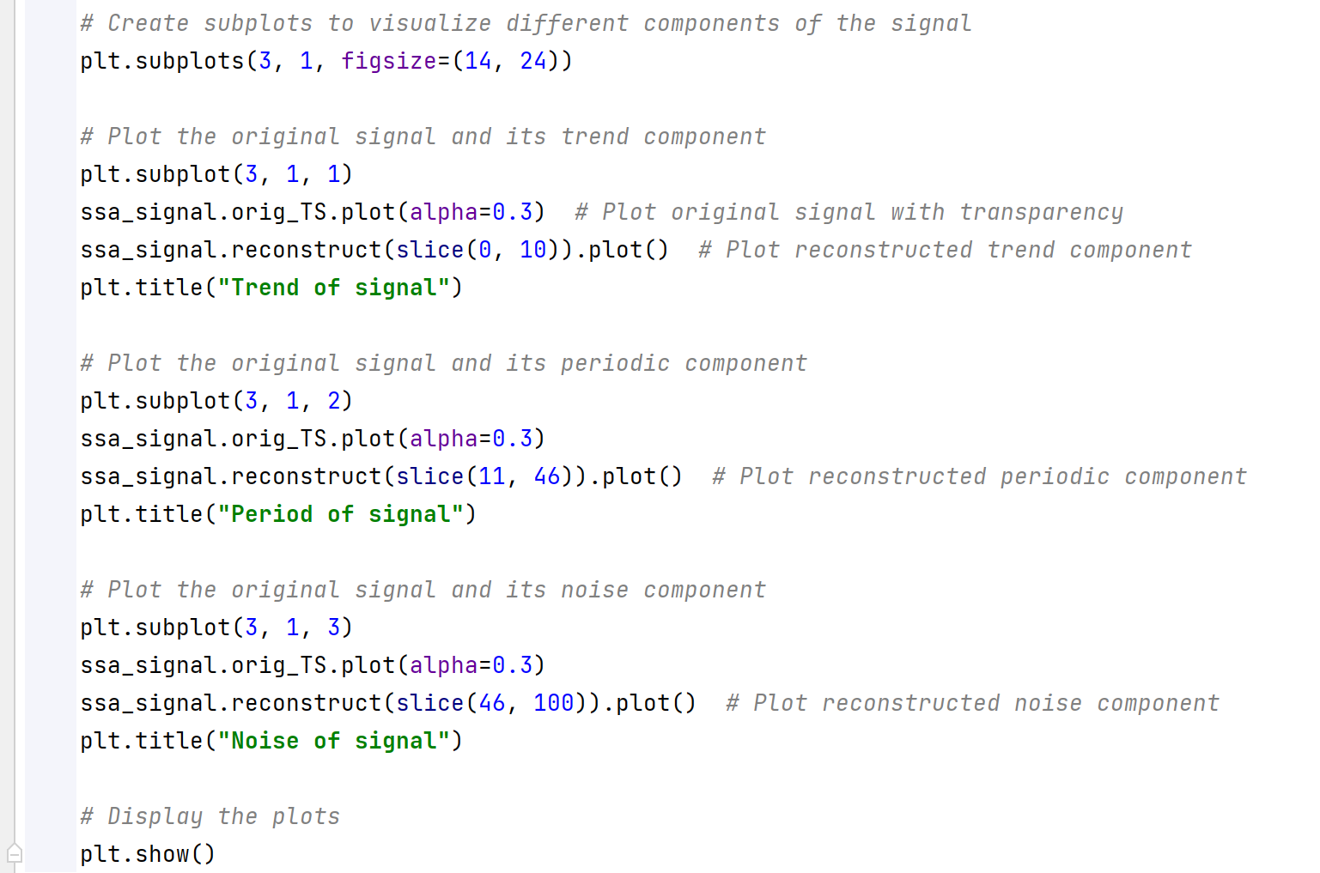
Work_3: Tutorial
Do these four Parts meet your requirement for this tutorial?
Part2. Example of Algorithm used in SCG
Part1. Implementation
Part4.
Code
Comments
Part3. Outputs of Example
Notes:
The work 3 is about tutorial
I need to confirm with you.
Currently, the tutorial has 4parts
Part1 is algorithm Implementation,
Part2 is Example of Algorithm used in our SCG signals
Part3 is Outputs of Example
Part4 is code comments
Do these four Parts meet your requirement for this tutorial? If they don't meet your requirements, what should I add?

Slide 17
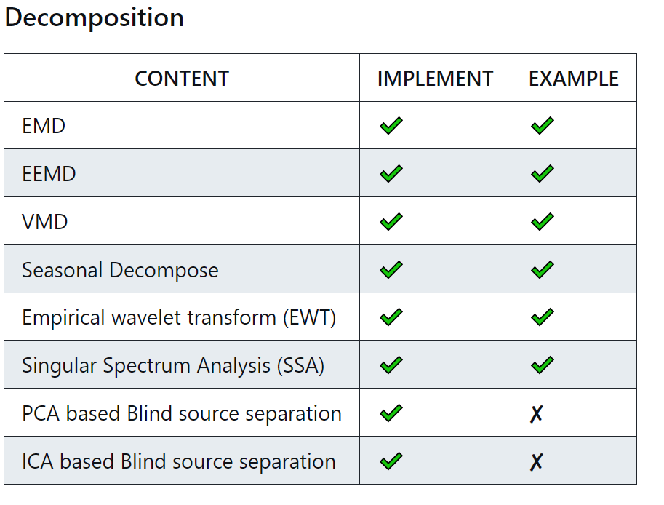
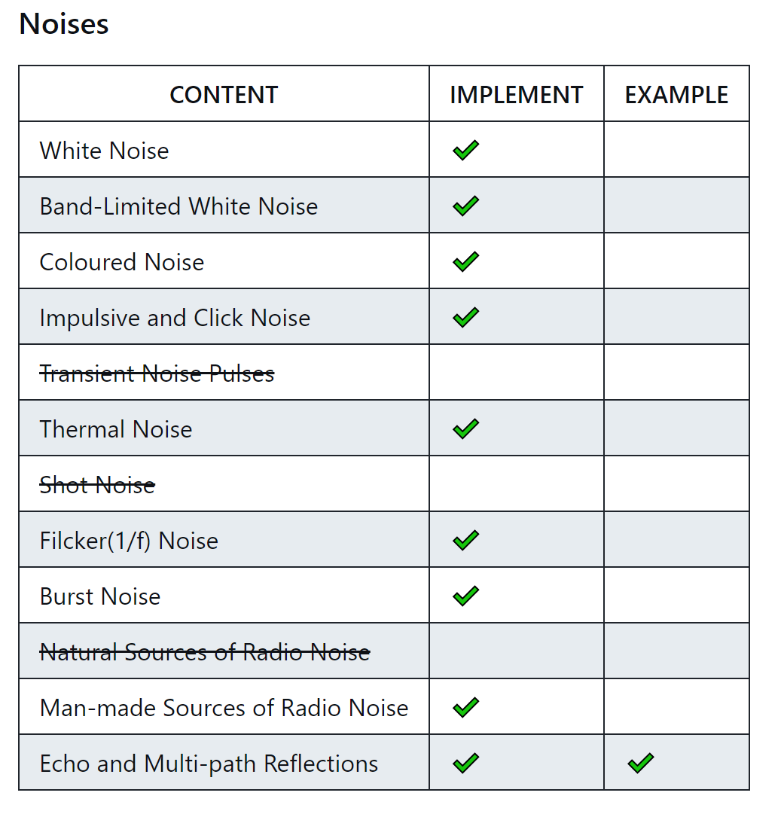
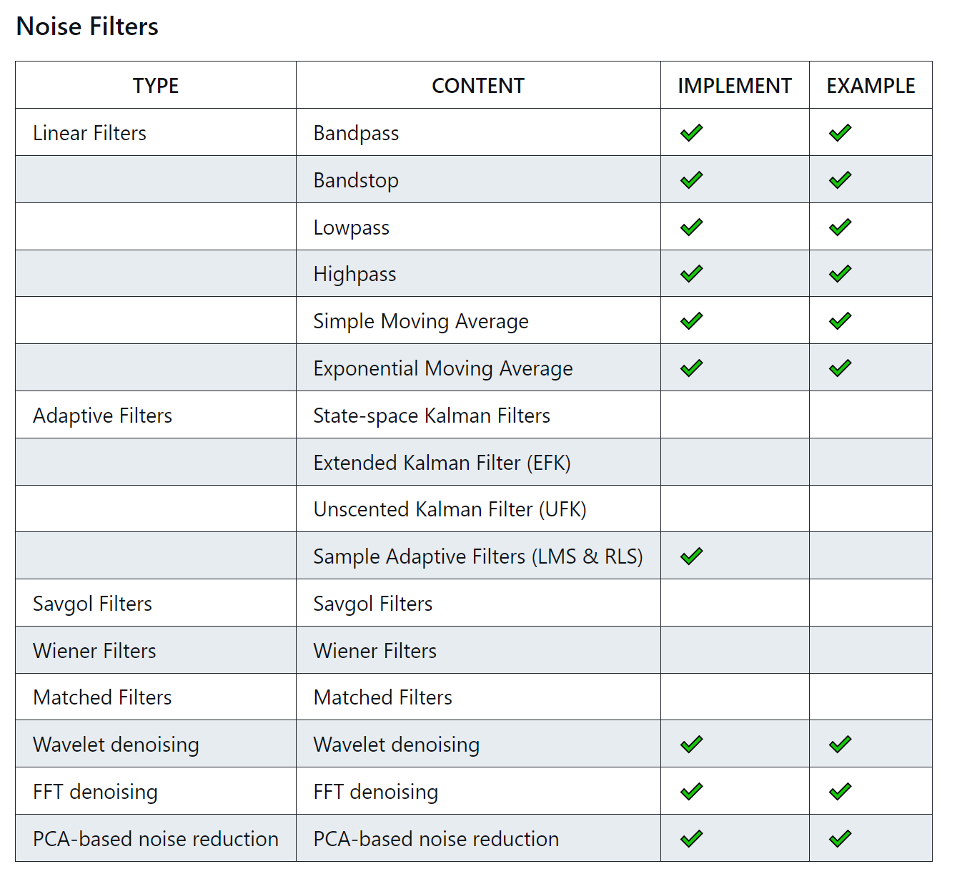
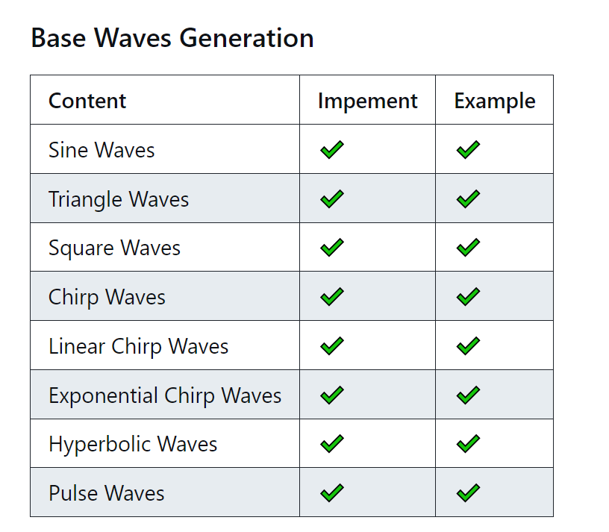
Work_3: Tutorial
Some advanced filters are not fully comprehensible at the moment. I will need to learn DSP and gradually work on implementing them.
Current SCG dataset doesn't provide a good example for algorithms, such as Blind Source Separation.
Notes:
Regarding the writing of the tutorial, it has reached a certain stage. The foundational content is mostly complete. The most challenging part in this section is the advanced filter. Some advanced filters are not completely understandable at the moment. I will need to learn DSP and gradually to implement them.
Currently, I'm also facing an issue: The current SCG dataset doesn't offer a suitable example for certain algorithms, such as Blind Source Separation.

Slide 18
Work_4: Theoretical knowledge Learning
Signals and Systems
Probability for Computer Scientists
Course: EE120, Berkeley
This week’s Progress:
Review 10 Lectures
Finish 1 lab
Next week’s plan:
Lecture 10 (the DFT; FIR filters)
Lecture 11 (Fourier transforms in two dimensions)
Finish 1 lab
Course: CS109, Standford
This week's progress:
Part * 12
Next week’s plan:
Part * 12
Notes:
This week, I have a hard time learning Hidden Markov Models.
I need to allocate some time to learning probability in order to better understand advanced concepts.

Slide 19
Questions
Do these four parts in my tutorial meet your requirement for this tutorial? If they don't meet your requirements, what should I add?
The SCG dataset is no longer suitable for many tutorial algorithms, for example, classifying signals. Should we build some simple datasets ourselves, or could you provide us with another simulated dataset?
What does this sentence mean in the document? It can be based on our SCG generator, and make it support different mother wavelets, such as Harr, Daubechies, Biorthogonal, Symlet, Meyer and Coiflets. I know the Nk2’s SCG simulation is based on Daubechies wavelet, should we use Harr or Symlet to simulate SCG?

Slide 20
Thanks!

